Slide 1
Today’s Podiatrist Does It All
Surgery Primary Care Research
Wound Care Pediatrics
Dermatology Radiology Trauma
Sports Medicine
Notes:
cPRESENTERS – PLEASE NOTE:
Items in the “Notes” section are talking points for each slide. Items in italics are suggestions for improving your presentation.
Please feel free to add additional slides as you see fit and as time allows. Students enjoy seeing the surgical photos, specifically the “before and after” shots. The APMA Slide Databank (on the APMA website – www.apma.org) may be of assistance to you as well.
The last slide (#17) can be customized on your computer to include your contact information. Delete the red type and add your own information.

Slide 2
Your Questions Answered
  What is Podiatric Medicine?
  What is a DPM?
  What is a typical day like for a DPM?
  What is the demand for foot and ankle care?
  How can you become a DPM?
Notes:
In today’s presentation I will first give you a brief overview of the podiatric medical profession.

Slide 3

What is Podiatric Medicine?
Medical and surgical care and treatment of the foot and ankle
Sub-specialties include sports medicine, surgery, pediatrics, geriatrics, and podiatric dermatology
An important part of the medical team
Notes:
The human foot is a complex structure. Designed for balance and mobility, the foot is made up of 26 bones and numerous muscles, nerves and ligaments. With all of these complex elements working together, it is easy to see how a specialist for this area of the body is necessary.
Podiatric medicine deals with the medical and surgical care and treatment of the foot and ankle. Podiatrists can have general practices or choose to specialize in specific areas such as sports medicine, surgery, pediatrics, geriatrics, pathology or diabetes.
Podiatric medicine plays an important role in the overall wellness for each individual. Since the foot may be the first area to show signs of serious conditions such as arthritis, diabetes, and heart disease, it is critical to get the specialized attention your feet need.

Slide 4
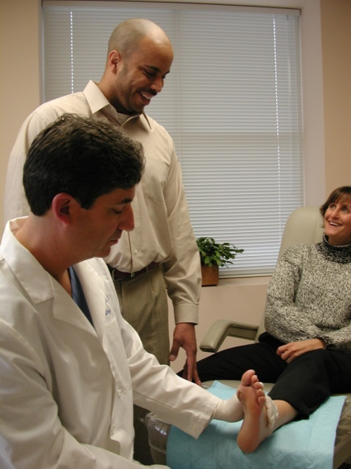
What is a DPM?
Doctor of Podiatric Medicine
More than just a “foot” doctor
Total health practitioner
  Conducts examinations
  Prescribes medications
  Performs surgery
Notes:
Because podiatric physicians deal with more than just the foot, they address more than just how the foot feels. DPMs often study the action of the ankle and lower leg by conducting gait analysis, the study of how people walk, and other research related to the foot and ankle.
Doctors of Podiatric Medicine provide a vast array of care to their patients. They prescribe drugs, order physical therapy, conduct examinations, set fractures, take x-rays, and perform surgery, both reconstructive and trauma. They also fit orthotics and design custom-made shoes. No other medical specialist enjoys such a wide range of care options.

Slide 5

Where Will You Find DPMs?
Private or group practices
HMOs, PPOs
Hospitals
Government such as Public Health, VA, health clinics, etc.
Medical schools
Military
University Teaching Hospitals
Notes:
In addition to many geographic choices available to the podiatric physician, there are a variety of settings or types of practices from which to choose.
As you review the list, you might cite podiatric physicians you know who
work in these different areas:
Private or group practices
Health maintenance organization (HMOs)
Preferred provider organizations (PPOs)
Hospitals
Government (Public Health, V.A., etc.)
Medical and podiatric medical schools
Military
University Teaching Hospitals

Slide 6




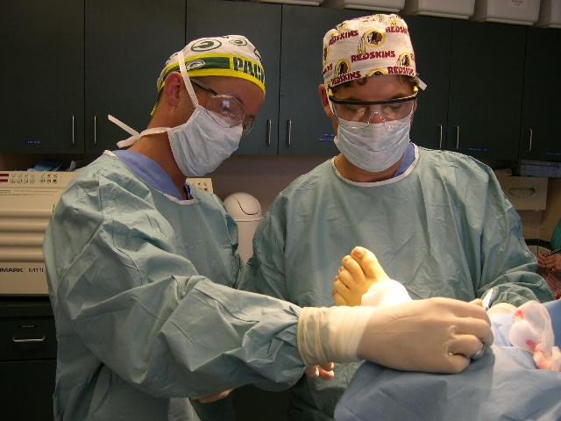

What is it Like to be a DPM?
Notes:
This is the most important part of the presentation. You will want to spend time reviewing a typical day (highlighting the vast variety of patients and conditions you see). We recommend that you insert your own experiences and background.
How many patients do you see on a typical day?
When do you get to work? When do you leave work?
What kind of care do you deliver in a normal day?
How much of your time is spent in surgery?
Are there patient success stories you can share?
Some sample discussion topics include: Trauma, Sports Medicine, Radiology, Endocrinology, etc.
Insert personal slides or slides of surgical procedures here. Feel free to visit the APMA website to download slides from the Slide Databank.

Slide 7

What is it Like to be a DPM?
The education of a medical specialist
4-4-3 model
The variety of a general practitioner
The rewards
  Relieving patients’ pain
  Keeping people active
  Healthy earning potential
Notes:
Other rewards include:
Taking people out of pain. When our feet hurt, it is different than when another part of us is in pain. Pain in our feet can restrict our movements and take away our independence very quickly. Being in a position to help people remain independent is a great place to be.
Keeping people active. In the same way that taking people out of pain makes you feel good, keeping people living active lifestyles is rewarding. As a doctor of podiatric medicine, you will help your patients participate more fully in their lives and in the activities that are important to them.
Podiatric medicine, like many medical careers, has outstanding earning potential. Currently there are approximately 14,000 DPMs in active practice. That is an average of one podiatric physician for every 20,408 people. Podiatrists receive 60 million patient visits a year.

Slide 8
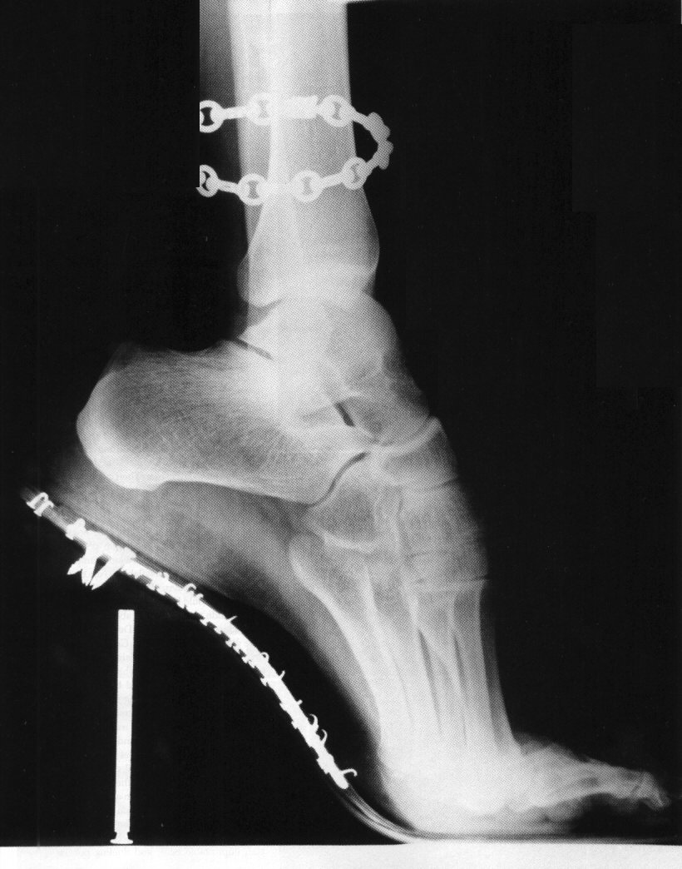
Why Become a DPM?
Strong demand for podiatric physicians
  Recent Workforce Study
  indicates a need to increase
  the number of podiatrists
Flexible work hours
Financial opportunities
Options in practice
Notes:
I’ve already mentioned some of the reasons why podiatric medicine is an outstanding career. Let’s review those once more before we go on:

Slide 9

Where Can You Study
Podiatric Medicine?
Miami Shores, Florida
Philadelphia, Pennsylvania
New York City
Independence, Ohio
North Chicago, Illinois
Des Moines, Iowa
Oakland, California
Glendale, Arizona
Pomona, California
Notes:
There are nine colleges of podiatric medicine located in the United States:
Barry University School of Graduate Medical Sciences in Miami Shores, Florida
Temple University School of Podiatric Medicine in Philadelphia, Pennsylvania
New York College of Podiatric Medicine in New York City
Ohio College of Podiatric Medicine in Independence, Ohio
Dr. William M. Scholl College of Podiatric Medicine at Rosalind Franklin University in North Chicago, Illinois
College of Podiatric Medicine and Surgery, Des Moines University in Des Moines, Iowa
California School of Podiatric Medicine at Samuel Merritt University in Oakland, California
Arizona Podiatric Medical Program at Midwestern University in Glendale, Arizona, and
Western University of Health Sciences School of Podiatric Medicine in Pomona, California
Here is where you can tell people where you went to school and how you chose to go there.

Slide 10

What are the Admission Requirements?
Complete at least three years (usually 4 yrs)
(90 hours) of undergraduate study with emphasis on sciences or pre-med curriculum
MCAT (Medical College Admissions Test)
Notes:
To enter a college of podiatric medicine, you must first complete at least three years or 90 semester hours of college credit at an accredited institution with an emphasis on sciences or pre-med curriculum. About 95 percent of the students who enter a college of podiatric medicine have a bachelors degree. Many have also completed some graduate study.
Prerequisites for colleges of podiatric medicine include: biology, general, organic and inorganic chemistry, physics and English.
Traditionally, the Medical College Admissions Test, or MCAT, has been the only standardized test required for admission to the colleges of podiatric medicine. However, some colleges will accept other test scores, such as the Graduate Record Exam (GRE) or DAT. Most students who enter podiatric medical schools have taken the MCAT.
Applicants who choose to take the MCAT as an entrance requirement must take it no later than spring of the year of admission.

Slide 11

What do DPM Students Study?
Years 1 & 2
  Classroom Instruction
  Anatomy, Biochemistry, etc.
Years 3 & 4
  Clinical Skills, Patient Care
  Physical Diagnosis, Surgery,
  Neurology, Dermatology,
  Biomechanics, etc.
All with a focus on the lower extremity
Notes:
The doctor of podiatric medicine degree or DPM is awarded after four years of study at one of the nine colleges of podiatric medicine in the United States.

Slide 12
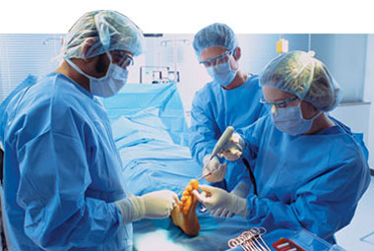
What about Residency?
Upon graduation, podiatric physicians are required to complete three years of postgraduate residency training
Some fellowships are available
for those wishing to continue
their education beyond
residency
Notes:
After completing four years of podiatric medical training, the podiatric physician is required by nearly all states to complete two to three years of postgraduate residency training in an approved healthcare institution. However, recent changes in the requirements now call for graduates to complete three years of residency training.
Residency programs are designed to strengthen and refine the practitioner’s podiatric medical and surgical knowledge and skills. The training program consists of a number of rotations, such as anesthesiology, internal medicine, radiology, infectious disease, surgery, orthopedics, emergency room and pediatrics.
All residency training includes non-surgical skills (medicine, biomechanics) and surgery, including advanced surgical experiences during the third year. Some students opt to continue training after the three year surgical programs with fellowships.

Slide 13

What is the Licensing and
Certification Process for DPMs?
National Boards are taken while in
podiatric medical school
Some states also require a written and/or oral exam prior
to licensure
Board certification is available in podiatric orthopedics & primary medicine (ABPM) and in
podiatric surgery (ABFAS)
Notes:
To become a licensed podiatric physician, students must complete a two-part National Board while in podiatric medical school and another part upon completion of the podiatric medical school program. Part One covers basic science areas; Part Two covers clinical areas and clinical judgment.
Although most states accept the results of the National Board Examinations, some states may also require another written and/or oral examination prior to licensing.
Podiatric physicians may also become certified in one (or both) of two specialty areas —primary medicine/orthopedics or surgery. National podiatric specialty boards grant certification to qualified podiatric physicians who have completed the specified educational requirements and who successfully complete written and oral examinations.

Slide 14

How Can You Apply to a
College of Podiatric Medicine?
Visit APMA.org,
AACPM.org, or
any of the nine college
websites
Complete the online application
Take advantage of mentoring opportunities through the DPM Mentor Network
Notes:
Applying to a college of college of podiatric medicine is not complicated, but does take some time and preparation.
Log onto the APMA’s website at www.apma.org or visit the American Association of Colleges of Podiatric Medicine (AACPM) website at www.aacpm.org. By the way, both websites are packed with additional information about the benefits of pursuing a career in podiatric medicine as well as information about each association and its programs.
Each of the nine colleges also has an individual website. Links can be found on the APMA’s site.
All students complete their application online. Follow the directions on the AACPM’s website.

Slide 15

What is the Application Process?
Submit an application through the online
American Association of Colleges of Podiatric Medicine Application Service (AACPMAS)
Letters of recommendation, transcripts,
and a personal interview are required
Financial aid is available at all schools
aacpm.org
Notes:
With the AACPMAS application service, there is only one application fee, which is paid to the Association; the individual colleges do not charge separate application fees.
Other requirements for admission include letters of recommendation, transcripts from all undergraduate institutions previously attended, as well as a personal interview.
Financial aid packages are an integral part of each student’s application and admissions process. All of the colleges offer financial aid and participate in many national and state financial aid programs. In addition, the profession supports a scholarship foundation which provides individual scholarships to students in their junior and senior years.
To access the AACPMAS application service, log onto the web at www.aacpm.org.

Slide 16
Today’s Podiatrist Does It All
Dr. Dennis R. Frisch
561-395-4243
BRPod@bellsouth.net
Todayspodiatrist.com
www.apma.org
Notes:
Whatever way you measure success, podiatric medicine can meet the standard: the satisfaction of alleviating human suffering; recognition from the community; job security and flexibility; financial opportunity; and time to have a family life.
As you can see, a career in podiatric medicine can be both rewarding, diversified, and interesting. I hope that some of you will one day consider podiatric medicine for your futures.
Thank you.
(It’s always a good idea to stay after the presentation for a few moments if your schedule allows. Many students are uncomfortable asking questions in a group setting and may want to ask personal questions on a one-to-one basis. Try to allow for this at the conclusion of the presentation.)
Please bring materials to distribute to students as well. APMA will provide you with brochures to distribute. Contact the APMA at the number below to order those brochures. (Please allow two weeks notice).
APMA
Recruitment Office
1-800-275-2762 ext. 281 or email to lnswain@apma.org

